Slide 1

Forecasting Neighborhood-Level Fire Risk in Montreal
Final Presentation
November 5th , 2025
1
Notes:
Ekue

Slide 2




TEAM 3
Hammed Akande
Osama Wanis
Pak Hang Lo
Ekué Afanou
Notes:
Ekue

Slide 3
Outlines
Context of the Project (What happened)
Datasets Explored (Which data do we have)
Target Variable (What We’re Predicting)
Features Identification and Creation (What Matters Most and What We Built)
Modelling Explored (Random Forest Classifier and ROE)
Evaluation & Results (How They Performed)
Recommendations
Conclusions
Notes:
Ekue

Slide 4
Introduction
(What happened)
Montreal has experienced costly urban fire incidents concentrated in specific neighborhoods and seasons, stretching prevention resources and exposing gaps in reactive, routine inspections.
This project was launched to shift from reactive response to proactive risk forecasting, guiding monthly hotspot inspections, outreach, and resource planning.
Notes:
Ekue

Slide 5
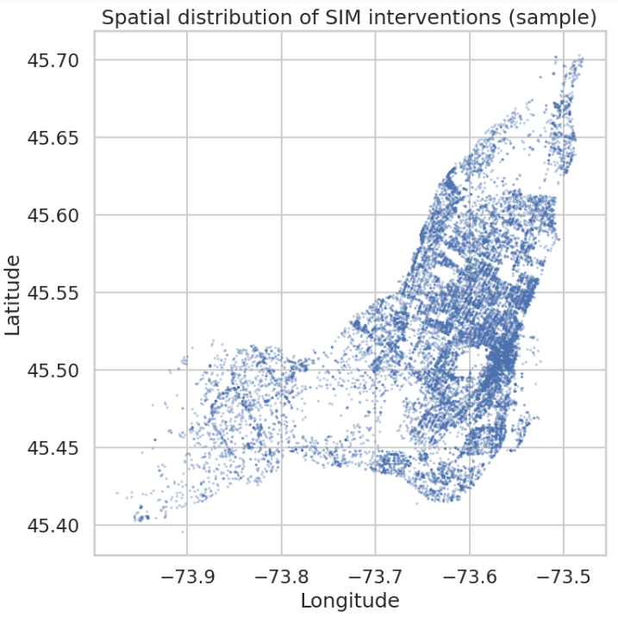
Datasets Explored (1)
(Which data do we used)
We used three datasets :
Fire Events: Event-level fire records aggregated to
Area × Month
Notes:
Ekue

Slide 6
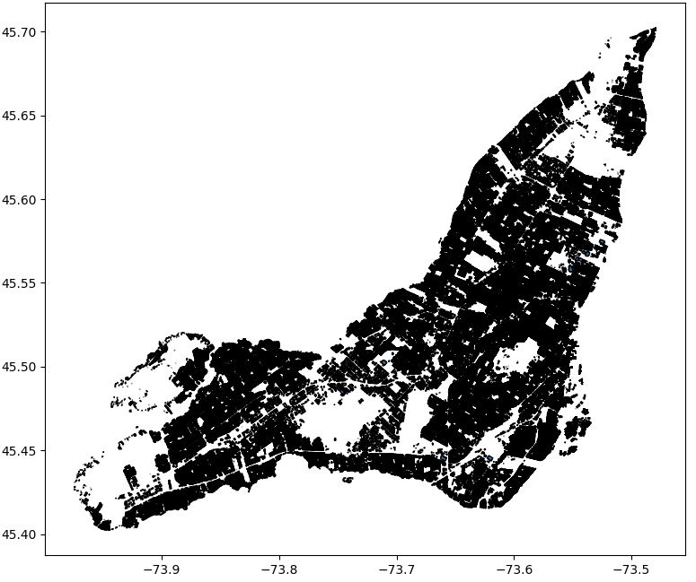
Datasets Explored (2)
(Which data do we used)
B) Building Assessment: City-wide building attributes (#buildings, #floors, year built).
Notes:
Ekue

Slide 7
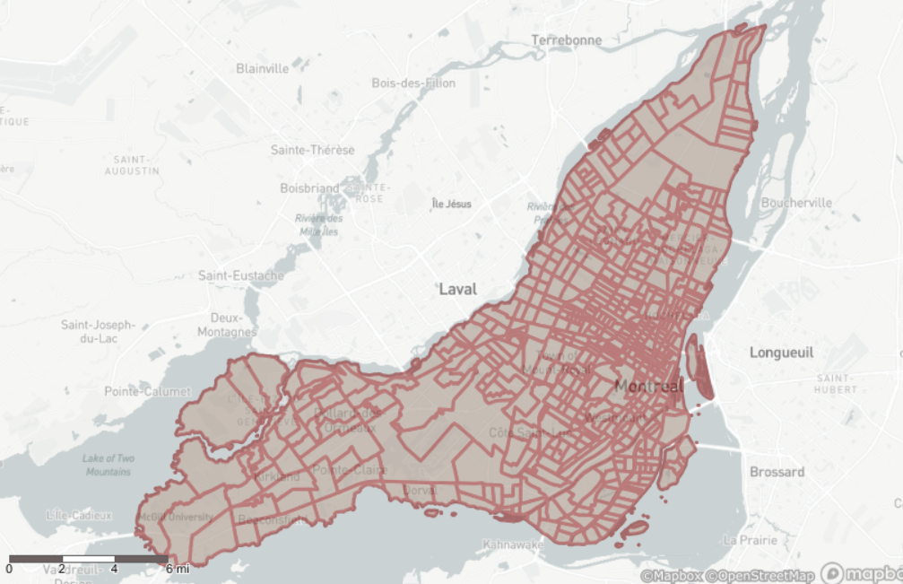
Datasets Explored (3)
(Which data do we used)
C) Census Data: City-wide census tract data (We converted WGS 84 to NAD 83 as the CRS).
Notes:
Ekue

Slide 8
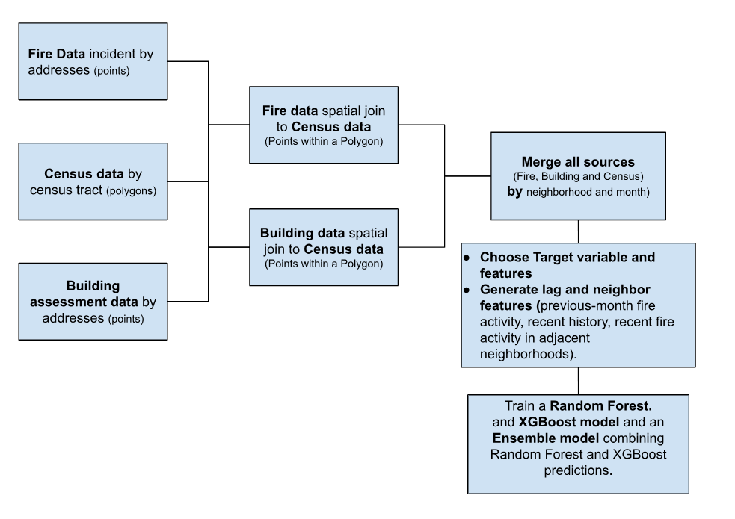
Combining datasets
Notes:
Ekue

Slide 9

Target Variable
(What We’re Predicting)
0 : ≤ 2* fire incidents in the area during the month.
We forecast one month ahead using data available up to the end of the current month.
*2 is the median in the fire dataset
1 : > 2* fire incidents in the area during the month.
Notes:
Sam

Slide 10
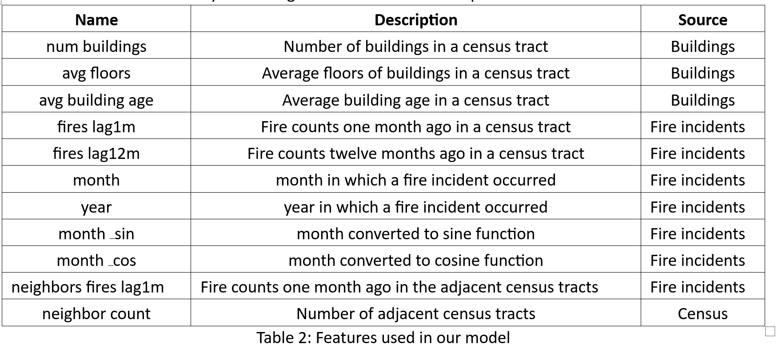
Features Identification and Creation
(What Matters Most and What We Built)
Transformation techniques used : Temporal lags, Seasonality, Spatial lag, External predictors
Notes:
Sam

Slide 11
Models Explored
Random Forest
XGBoost
Ensemble (RF + XGB, majority vote)
Notes:
Sam

Slide 12
Rolling Origin Evaluation (ROE)
Train: Sep 2005 - Aug 2021
Hyper Param tuning:
Sep 2021 - Aug 2022
Prediction:
Sep 2022
Train: Sep 2005 - Sep 2022
Prediction:
Oct 2022
Train: Sep 2005 - Oct 2022
Prediction:
Nov 2022
*
*
*
*
*
*
*
*
*
*
*
*
Train: Sep 2005 - Aug 2025
Prediction:
Sep 2025

Slide 13
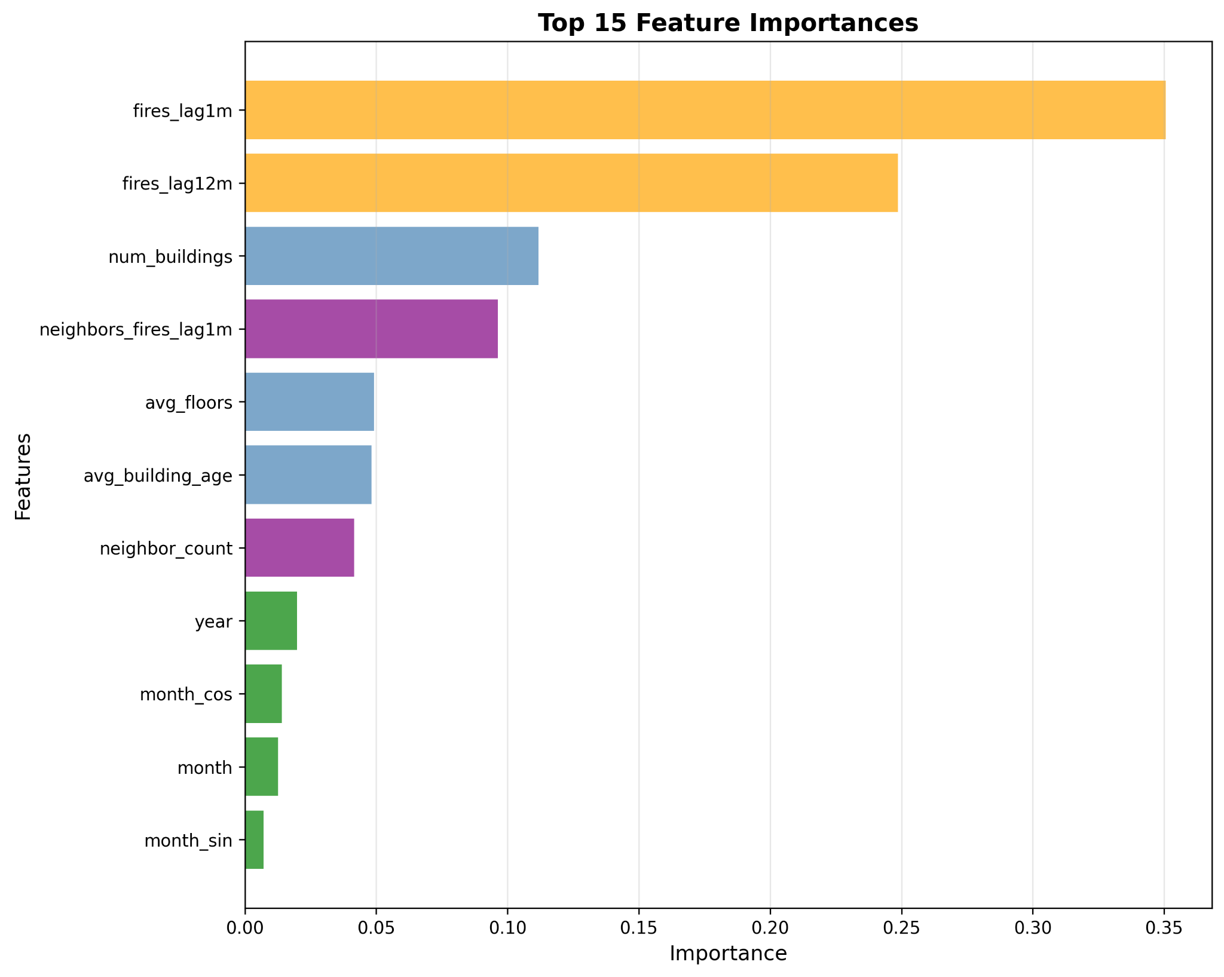
Evaluation & Results (1)

Slide 14
Evaluation & Results (2)
The model demonstrates strong temporal stability, maintaining consistent F1 scores (0.55-0.77) across the 37-month evaluation period.
Model | Balanced Acc | Precision | Recall | F1 Score
Random Forest | 0.71 | 0.69 | 0.69 | 0.69
XGBoost | 0.70 | 0.73 | 0.59 | 0.65
Ensemble | 0.71 | 0.69 | 0.69 | 0.69

Slide 15
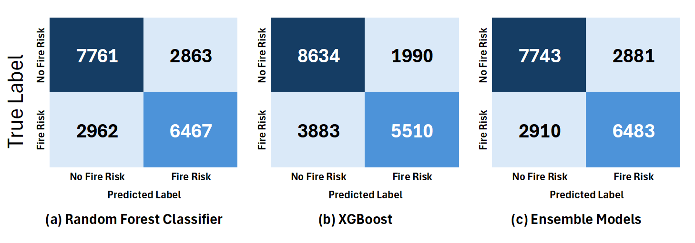
Evaluation & Results (3)
Confusion Matrix

Slide 16
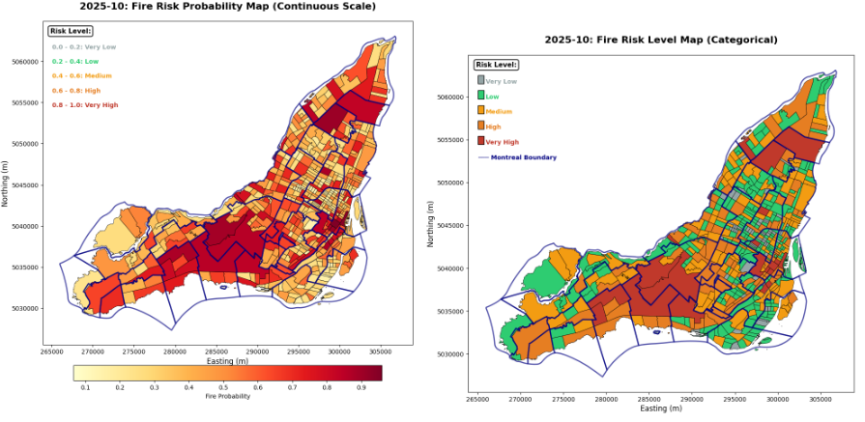
Prediction on October 2025

Slide 17
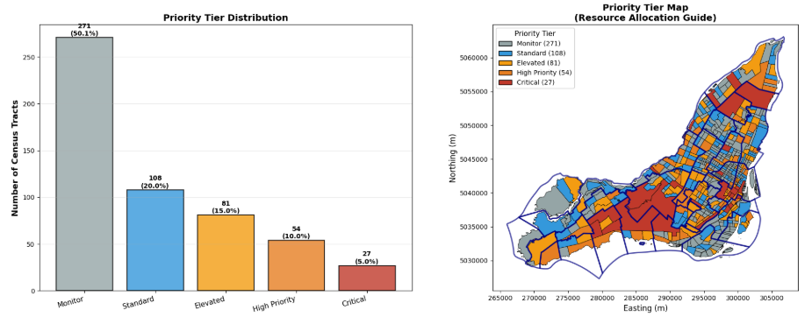
Prediction on October 2025
Five-tier risk stratification for October 2025. Critical tier (5% of areas) represents highest-priority targets for immediate fire prevention intervention.

Slide 18
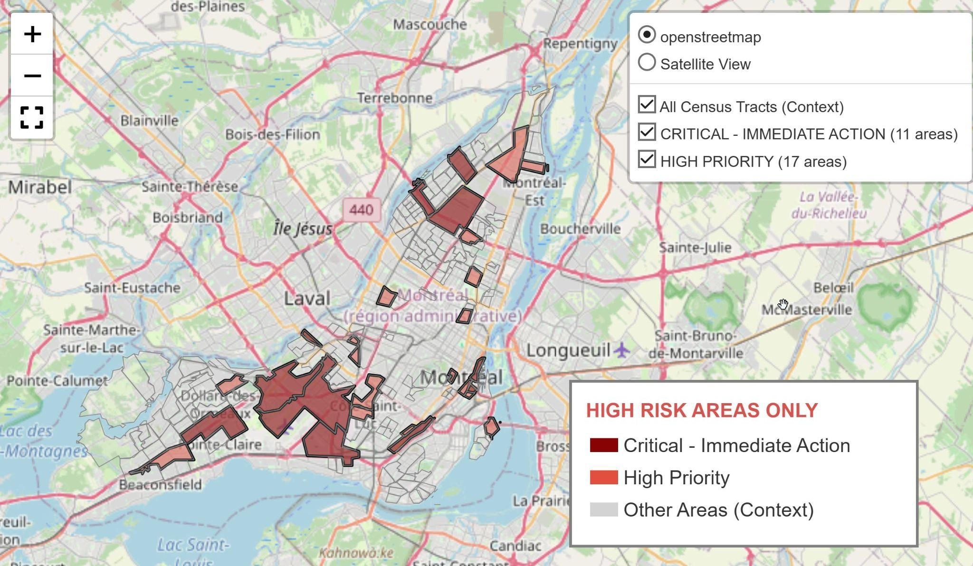
Recommendations (1)
High Risk and Critical Areas or October 2025 (Prediction)
Dynamic inspection prioritization: Schedule more frequent inspections in high-risk areas; update priority zones monthly/quarterly with new data.
Notes:
Dynamic Inspection Prioritization: Use model outputs to schedule inspections more frequently in
high-risk areas, updating the priority zones monthly/quarterly based on new data and model retraining
results.
2. Regular Model Maintenance Cycle: Establish a maintenance schedule that includes periodic retraining,
feature updates, and performance monitoring (e.g., tracking AUC, recall, and precision drift) to ensure
continued accuracy over time.

Slide 19
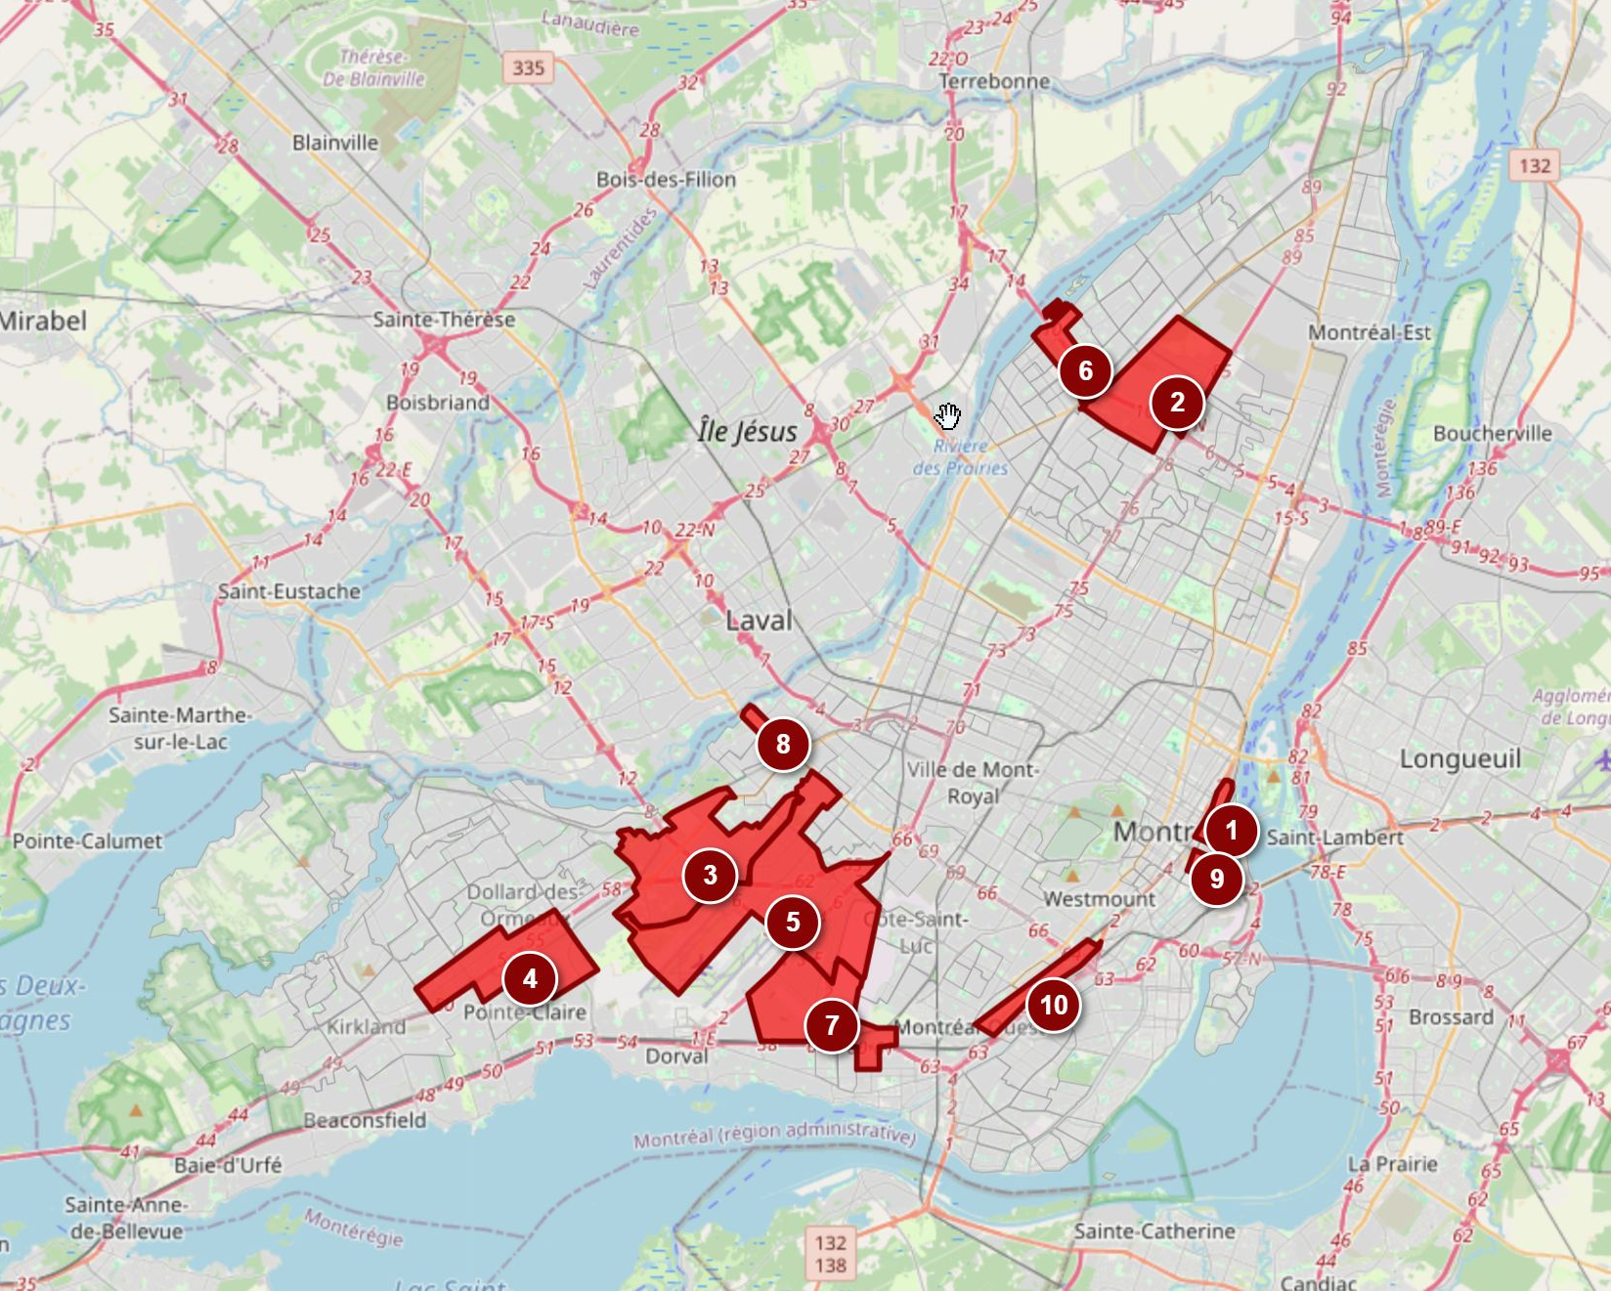
Recommendations (2)
TOP 10 High Risk Areas for October 2025 (predictions
Model maintenance: Set a regular retraining cycle with feature updates and performance checks.

Slide 20
Conclusion
We developed a machine learning framework for predicting fire risk in Montreal census tracts, achieving an F1 score of 0.68 through an ensemble of Random Forest and XGBoost models.
The analysis reveals important findings about urban fire risk and demonstrates the potential for data-driven fire prevention resource allocation.

Slide 21
Thank you very much!

